Slide 1
Housing Recovery
Presentation to
Community and Public Health
Advisory Committee
29 April 2014

Slide 2
Today’s presentation
Provide an overview of pre-and post earthquake
Will look at the major housing issues now for greater Christchurch
Outline CERA and MBIE’s roles and agency responses
Discuss what else could be done

Slide 3
Housing Overview - Christchurch
In Greater Christchurch prior to the earthquakes:
About 190,000 dwellings in greater Christchurch
Around one-third in the rental market
60% of new tenancies rented for less than $300 a week
Social housing numbers – 2600 CCC and 6000 HNZC plus several hundred NGO
Notes:
These next ## slides look at the housing situation in both greater Christchurch and nationally.
First a brief look at ChCh housing situation pre-earthquake.

Slide 4
Housing Overview - Christchurch (2)
Housing situation after the earthquakes:
Damage to about 90% of dwellings; and a total loss of 12,000 houses (red zoned + other uninhabitable)
Less than 25% of new tenancies are rented for less than $300 a week
CCC stock reduced by 400 to 2200 (red zoned, damaged); HNZC stock reduced 500 to 5500 (red zoned, damaged)
Notes:
Less rental stock available on market - the number of bonds lodged has fallen 20% to the lowest level since 1998

Slide 5
Agency Roles
CERA – earthquake-related housing issues: repair and rebuild of damaged homes; recovery plans
MBIE – national overview on housing affordability and quality, and building system improvements
Joint CERA-MBIE Housing Recovery Programme
CDHB – keep abreast of issues and identify local solutions
Other agencies have key roles – e.g. local government and planning

Slide 6
Three major housing issues
Following slides will look at three major housing issues in greater Christchurch:
Rental affordability and availability
Housing availability for most vulnerable
Damaged houses/quality

Slide 7
Issue One:
Rental affordability and availability
Issue: rising rents and less availability increases stress, housing-related poverty, overcrowding and homelessness
Evidence:
  average rents have increased by 44% since the earthquakes
  number of new bonds lodged has dropped to lowest level since 1998;
  CERA’s Community Well-Being survey results shows housing stress is an issue

Slide 8
Rental affordability and availability (2)
Agency responses:
  Temporary villages (124 houses over 4 villages); Temporary Accommodation Assistance – 937 households at present
  $75 million new housing fund
  Awatea development – 275 houses, potential development of 350 Colombo and 36 Welles Sts, other projects
  Land Use Recovery Plan – easier for affordable housing developments
Forecast: rental affordability will worsen this year, plateau and start to improve 2015/16 onwards, market stability by 2019

Slide 9
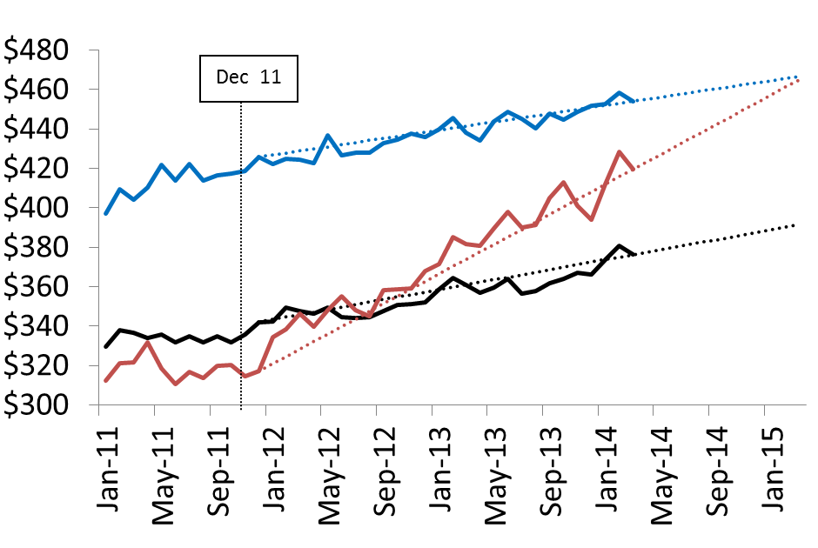
Christchurch rents forecast
By early 2015, rents will be on par with Auckland’s:
Notes:
Less rental stock available on market - the number of bonds lodged has fallen 20% to the lowest level since 1998

Slide 10
Issue Two:
Housing for most vulnerable
Issue: less social housing and low cost private rental housing available. Increased stress, housing-related poverty, overcrowding , homelessness.
Evidence:
  Loss of stock: at least 250 rooms in private inner city boarding houses lost, reduced stock for HNZC and CCC.
  Increased demand: HNZC wait list is now close to 500 for people in A priority (urgent, serious need) and B priority (serious need). CCC wait list in mid-200s.

Slide 11
Housing for most vulnerable (2)
Agency responses:
  HNZC – building 700 new state houses by December 2015. Bringing 300 damaged houses back into use by December 2014.
  CCC – will repair or replace lost stock by June 2016
  MBIE – funding for NGO social housing providers increased – with 126 dwellings funded
  MSD – now doing needs assessment for state housing
Forecast: will get worse before gets better – expect HNZC wait list to increase in short-term. By December 2015 HNZC wait list should have reduced to pre-earthquake levels

Slide 12
Damaged land and houses/quality
Issue: people living in damaged houses and facing their 4th winter; damaged land leading to flooding; health impacts from living in damaged housing and with damaged land
Evidence:
  rate of repairs/rebuilds reported by insurers and EQC is slowing;
  people identified through the Let’s Find and Fix campaign;
  complaints about insurance settlement process received via the Residential Advisory Service

Slide 13
Damaged houses/quality (2)
Agency responses
  CERA – Residential Advisory Service, Winter Make it Right, supporting Find and Fix, working with insurers on roadblocks
  HNZC – repairing 5000 houses by December 2015. Will take opportunity to undertake other improvements at same time.
  MBIE, CERA supporting Build Back Smarter pilot
  MBIE – technical guidance for repairs
  CCC – lead on flooding
Forecast:
  EQC completion date end 2014, private insurers 2016/17
  May be issues with quality of some repairs, however overall housing stock quality should improve
  Land issues will take time to resolve

Slide 14
Discussion and Questions
What issues are concerning you most about housing in greater Christchurch?
What other actions could Government or local government undertake?

